Slide 1
Microsoft AI Skills Fest

Slide 2
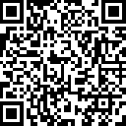
Welcome to the Microsoft AI Skills Fest
Housekeeping/Setup slide, external | 1 step
Before we get started make sure you register and follow the steps to earn your badge.
Join our fun GUINNESS WORLD RECORDS™ title attempt
Earn your badge:
Step 1: If you haven’t yet, take a moment to register: https://aka.ms/AISkillsFest
Step 2: Attend this session
Step 3: Complete a final step (shared at the end)
Notes:
30 sec | [Slide: Session Housekeeping & Setup] (Slide 3)
Here are a few quick reminders to get the most out of this session:
Join the GUINNESS WORLD RECORDS™ title attempt!
If you haven’t registered yet, take a moment now so you don’t miss out on this exciting record-breaking attempt.
You’ll be asked to provide an email where we’ll send your badge after the session.
How to earn your badge? Attend this session and complete a simple step we’ll share at the end!
Great! Now that we’re set up, let’s talk about what we’ll be covering today.

Slide 3

Welcome to the Microsoft AI Skills Fest
Housekeeping/Setup slide, external | 2 steps
Before we get started make sure you register and follow the steps to earn your badge.
1
2
Join our fun GUINNESS WORLD RECORDS™ title attempt
Ask questions and share your thoughts
Earn your badge:
Step 1: If you haven’t yet, take a moment to register: https://aka.ms/AISkillsFest
Step 2: Attend this session
Step 3: Complete a final step (shared at the end)
With your peers and our Microsoft AI Experts (“Live Moderators”) in the chat
Notes:
30 sec | [Slide: Session Housekeeping & Setup] (Slide 3)
Here are a few quick reminders to get the most out of this session:
Join the GUINNESS WORLD RECORDS™ title attempt!
If you haven’t registered yet, take a moment now so you don’t miss out on this exciting record-breaking attempt.
You’ll be asked to provide an email where we’ll send your badge after the session.
How to earn your badge? Attend this session and complete a simple step we’ll share at the end!
Engage with your peers and experts! Learning is better when we do it together. Drop your questions and thoughts in the chat as we go. We have Microsoft AI experts on standby, ready to help.
Great! Now that we’re set up, let’s talk about what we’ll be covering today.

Slide 4

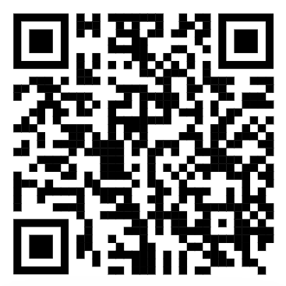
Welcome to the Microsoft AI Skills Fest
Housekeeping/Setup slide, external | 3 steps Business Pro
Before we get started make sure you register and follow the steps to earn your badge.
1
2
3
Join our fun GUINNESS WORLD RECORDS™ title attempt
Be ready for an interactive exercise using Microsoft Copilot
Ask questions and share your thoughts
Earn your badge:
Step 1: If you haven’t yet, take a moment to register: https://aka.ms/AISkillsFest
Step 2: Attend this session
Step 3: Complete a final step (shared at the end)
How? Open Copilot in another browser
With your peers and our Microsoft AI Experts (“Live Moderators”) in the chat
https://copilot.microsoft.com/
Notes:
30 sec | [Slide: Session Housekeeping & Setup] (Slide 3)
Here are a few quick reminders to get the most out of this session:
Join the GUINNESS WORLD RECORDS™ title attempt!
If you haven’t registered yet, take a moment now so you don’t miss out on this exciting record-breaking attempt.
You’ll be asked to provide an email where we’ll send your badge after the session.
How to earn your badge? Attend this session and complete a simple step we’ll share at the end!
There will be a mini-interactive exercise using Microsoft Copilot. To get ready, let’s open Copilot in another browser tab so you’re all set when we get to that part.
Engage with your peers and experts! Learning is better when we do it together. Drop your questions and thoughts in the chat as we go. We have Microsoft AI experts on standby, ready to help.
Great! Now that we’re set up, let’s talk about what we’ll be covering today.

Slide 5

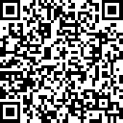

Closing/Reminder, external
1
Confirm your participation
Verify your involvement on the attestation page for the GUINNESS WORLD RECORDS™ title attempt
https://aka.ms/TrainingAffirmation
Congratulations
You’ve achieved a new AI learning milestone
2
Share your success
Show off your achievement—post your milestone with #AISkillsFest
Most users to take an online multi-level artificial intelligence lesson in 24 hours. April 8, 2025
Notes:
1.5 min | [Closing & Reminder]
To celebrate your achievement, make sure to claim your special badge—awarded by GUINNESS WORLD RECORDS through this AI Skills Fest event. How? Make sure to take steps on the screen. Take a moment to acknowledge your progress—this is a unique achievement!
Also, remember to share your success—you should feel proud of yourself achieving this milestone. Share what you learned in this session on LinkedIn or with your own network. Tag your colleagues and friends who might benefit from AI skills training. Use the hashtag #AISkillsFest to connect with others on their AI journey.

Slide 6
Thank you for attending

Slide 7
Title

